Slide 1
API Star ✨🚀✨🌟
Next generation framework!

Slide 2

A bit about myself
{
“name”: “Nir Galon”,
“twitter”: “@nirgn975”,
“github”: “github.com/nirgn975”
“website”: “www.nirgn.com”
}

Slide 3
Flask + Flask RESTful
/
Django + Django REST framework

Slide 5
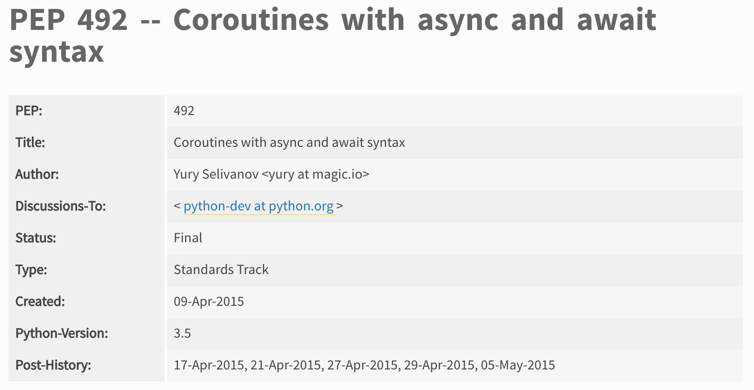
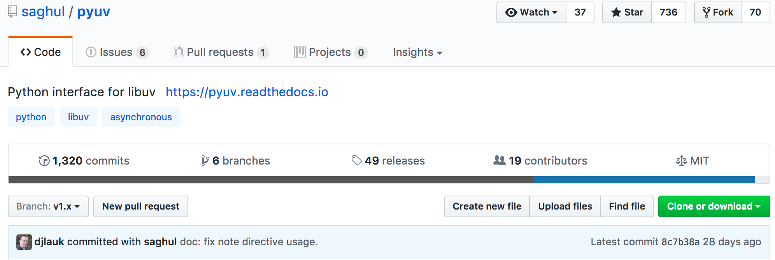
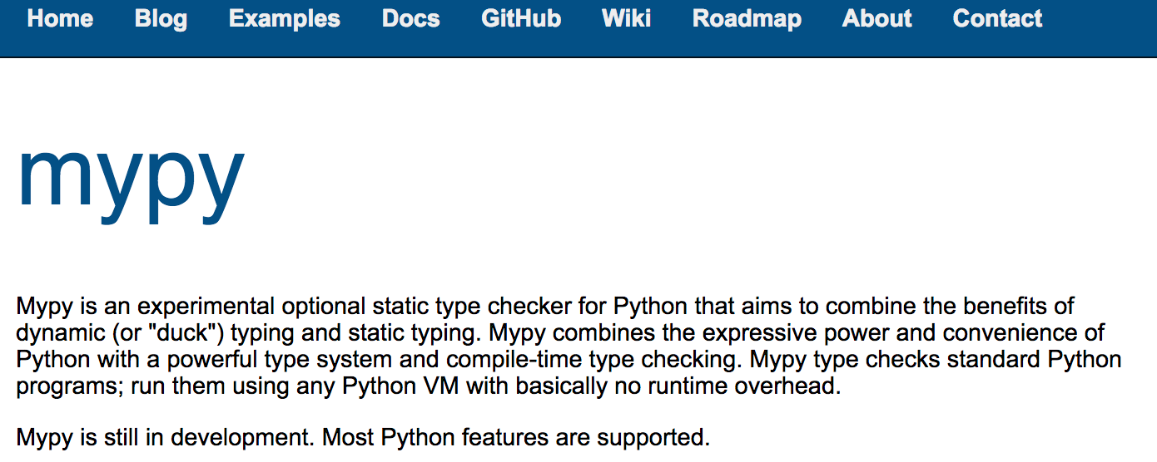
But lately..
async and await
pyuv (uvlib)
mypy

Slide 6
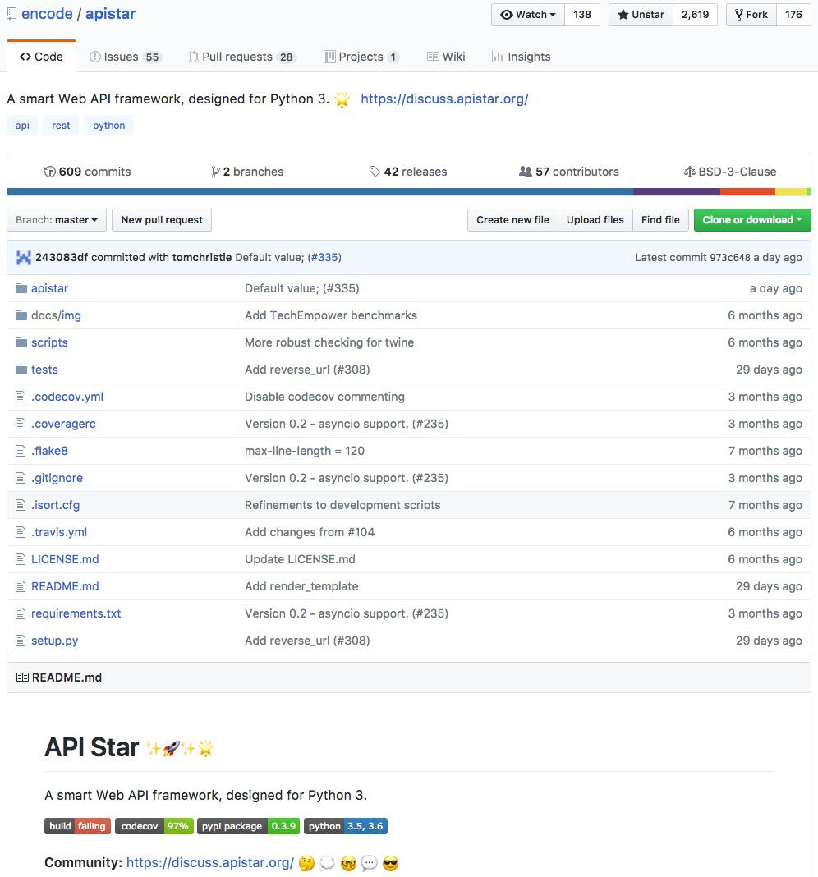
API Star
What it is:
A powerful web framework to build expressive APIs.
Function annotation for dependency injection.
Type system that can be declare our schema constraints.
Support for asyncio to allow for building high-throughput non-blocking applications.
Dev server, tests, automatic schema documentation, etc.

Slide 7
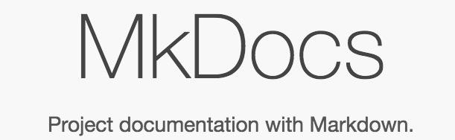

Written by Tom Christie
www.tomchristie.com
@_tomchristie
https://github.com/tomchristie

Slide 8
Play time!

Slide 9
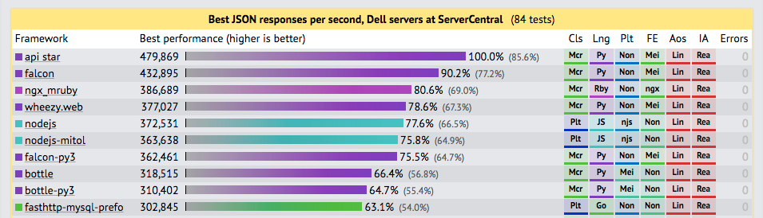
API Star - A smart Web API framework, designed for python 3

Slide 10

Thanks!
Contact me:
Nir Galon
Email: nir@galon.io
Website: http://nirgn.com
Twitter: @nirgn975
GitHub: nirgn975

